Slide 1
Using Perception for mobile robot

Slide 2
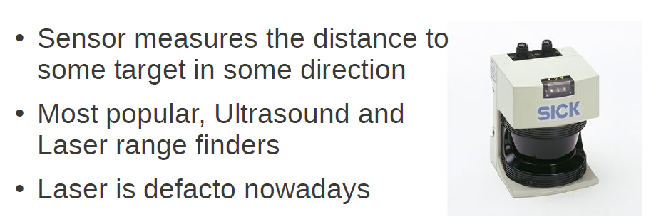
2D ranging for mobile robot

Slide 3
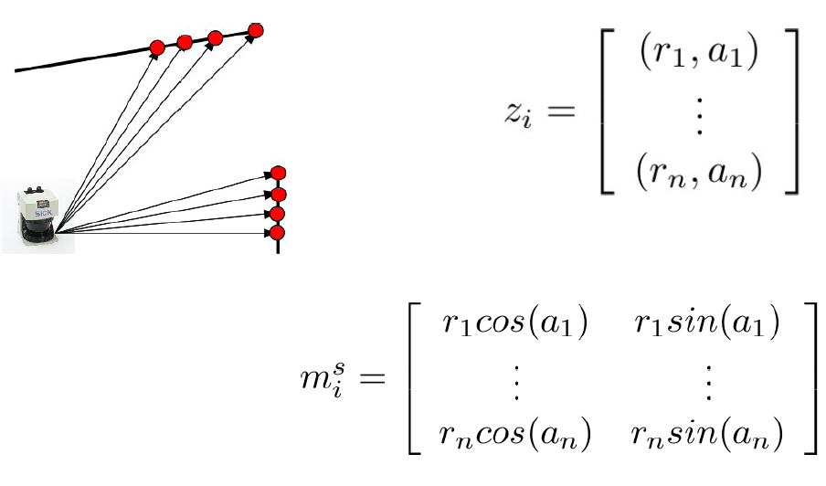
Laser Measurement
Laser measurement is a series of pairs of distance and angle
angle
distance
r
α
x/r = cosα

Slide 4
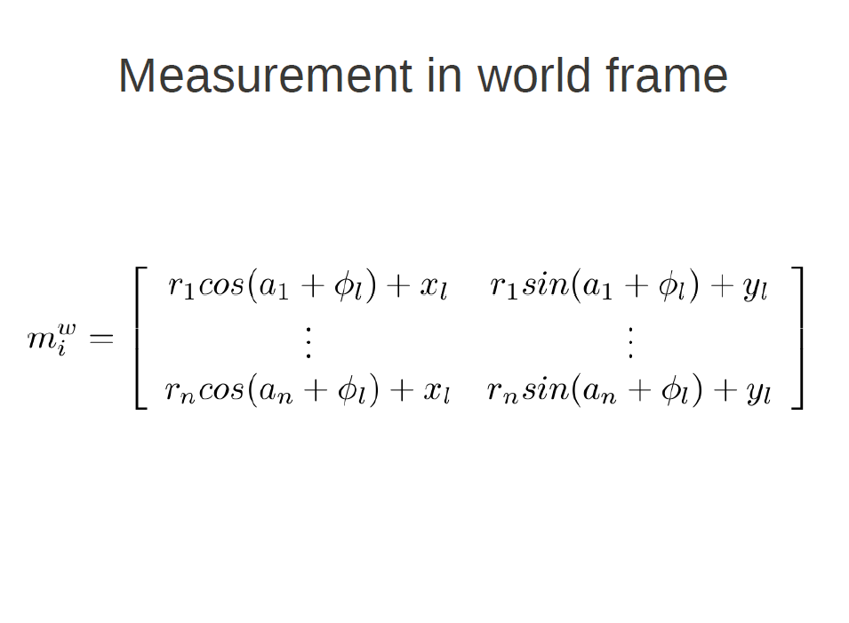
For global frame
In general, we have to add noise

Slide 5
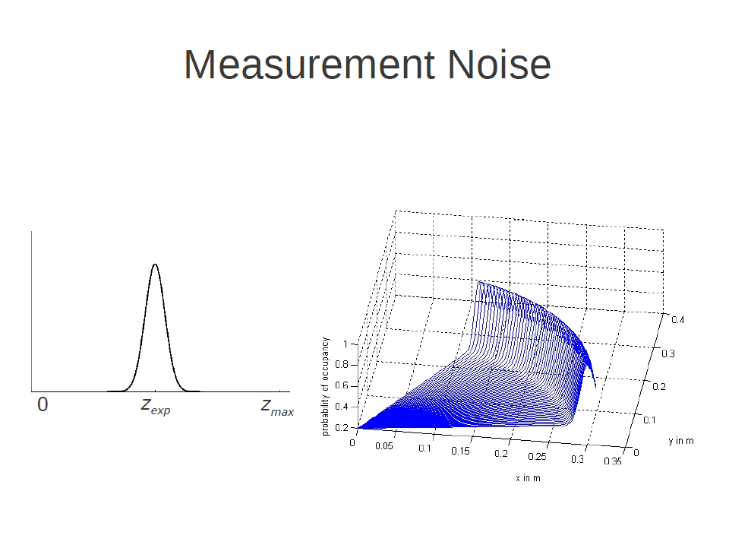

Slide 6
Homework Exercise

Slide 7
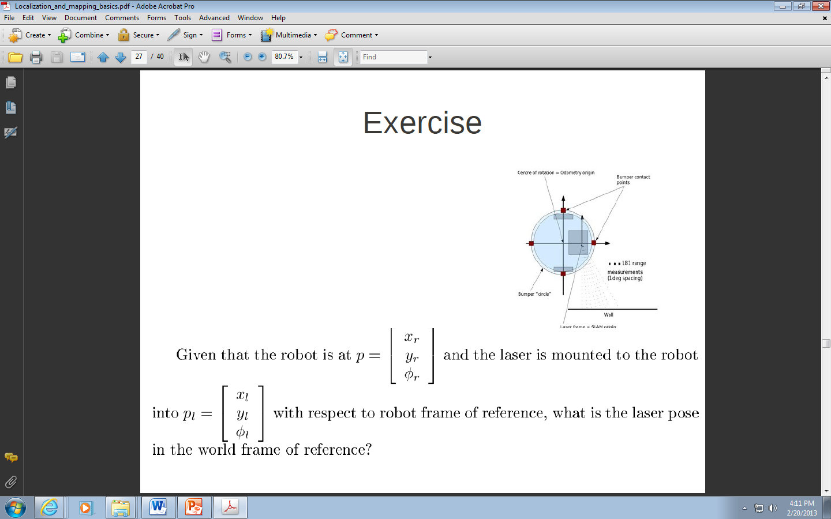
Centre of rotation = odometry origin
Bumper contact points
Bumper circle
WALL
Laser frame = SLAM origin

Slide 9
Methods for scan (and map) matching

Slide 10
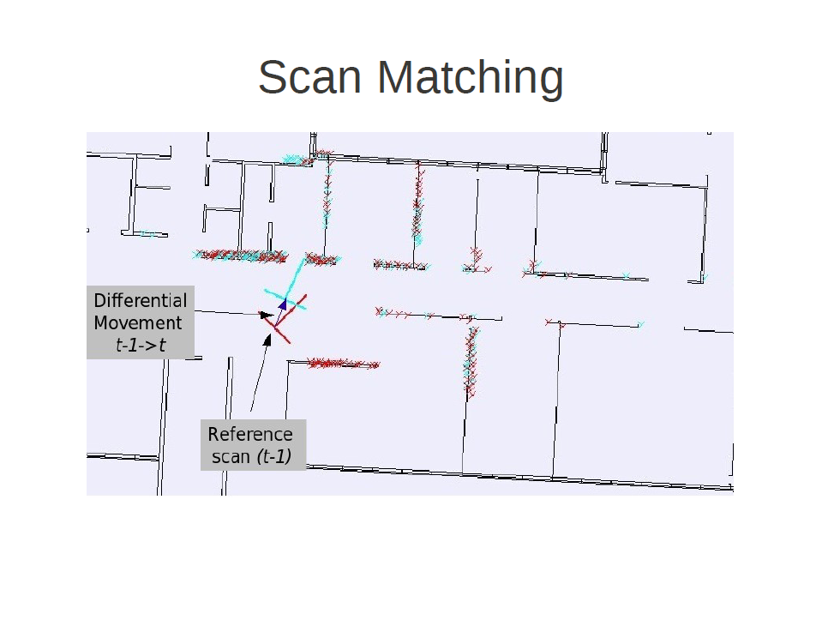
Our robot moves and rotates from t-1 to t
It takes scans

Slide 11
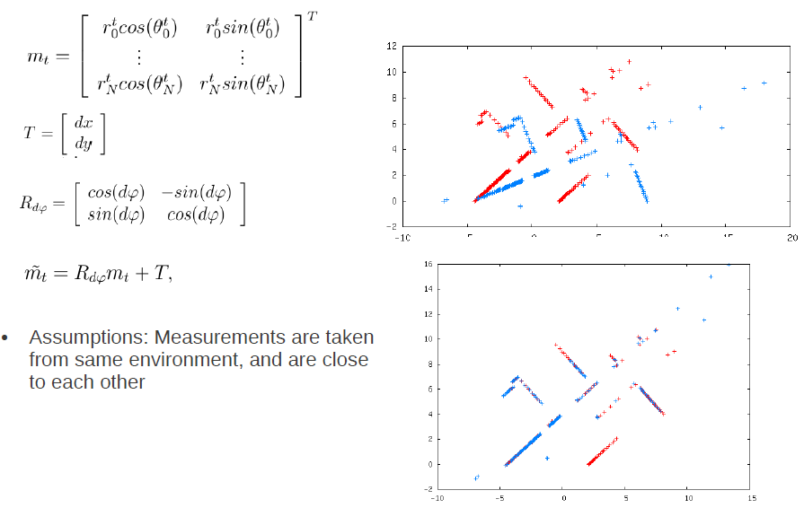
Scan Matching

Slide 12
Two Scan Matching Approaches
Search in feature space
  Look for corresponding features and form transformation accordingly
Search in pose space
  Find a pose that provides the best correlation
Use translation invariant transformations

Slide 13
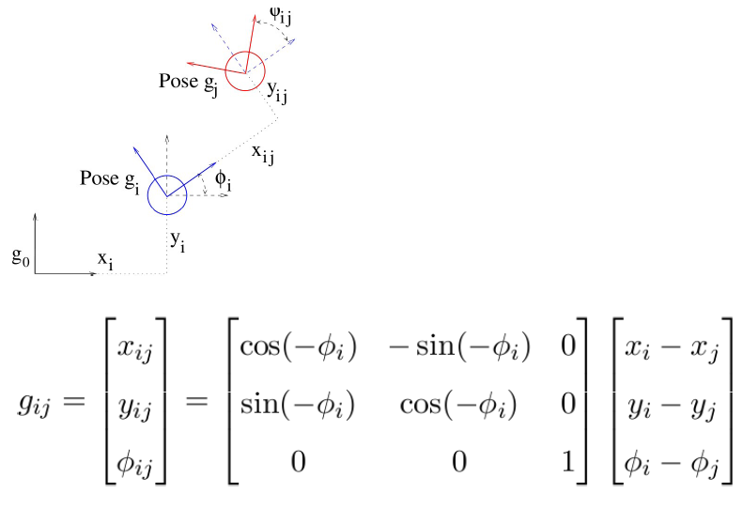
Using odometry as an initial guess
rotation

Slide 14
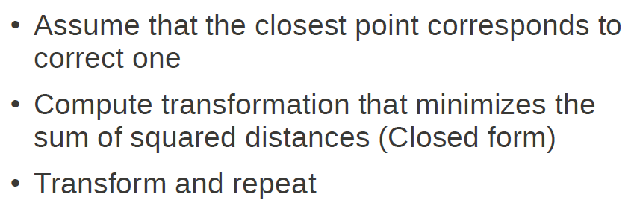
The method of ICP (Iterated Closest Point)

Slide 15
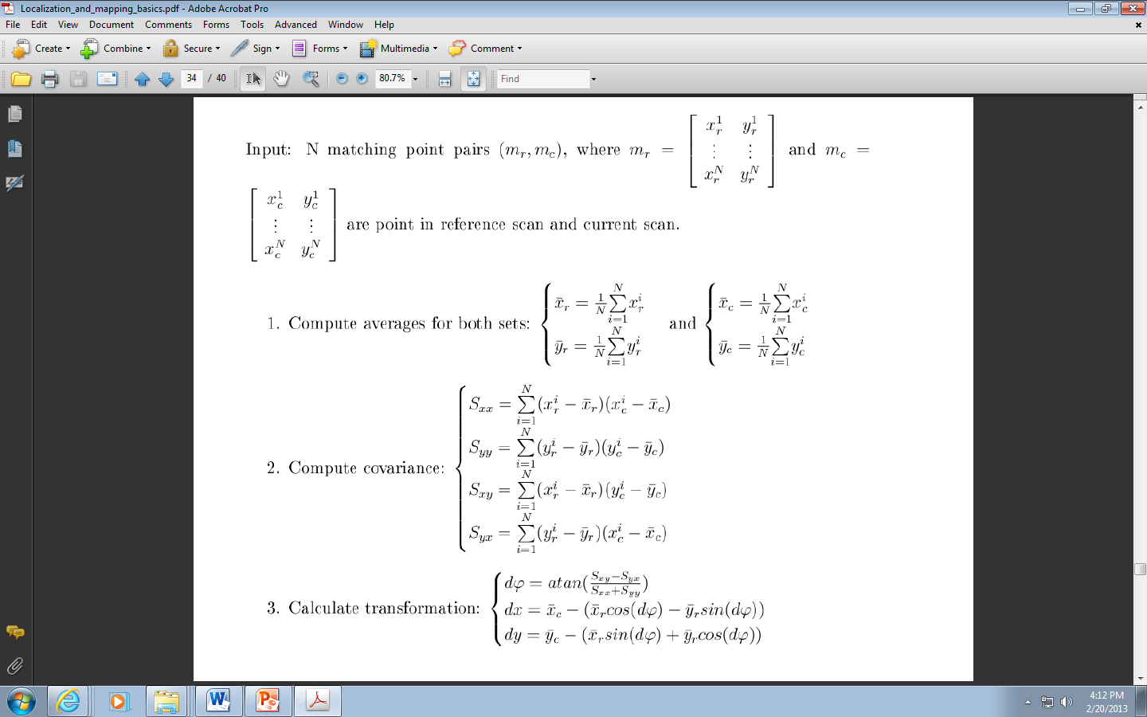
The method of ICP (Iterated Closest Point)

Slide 16
continued

Slide 17
Correlation in pose space

Slide 18
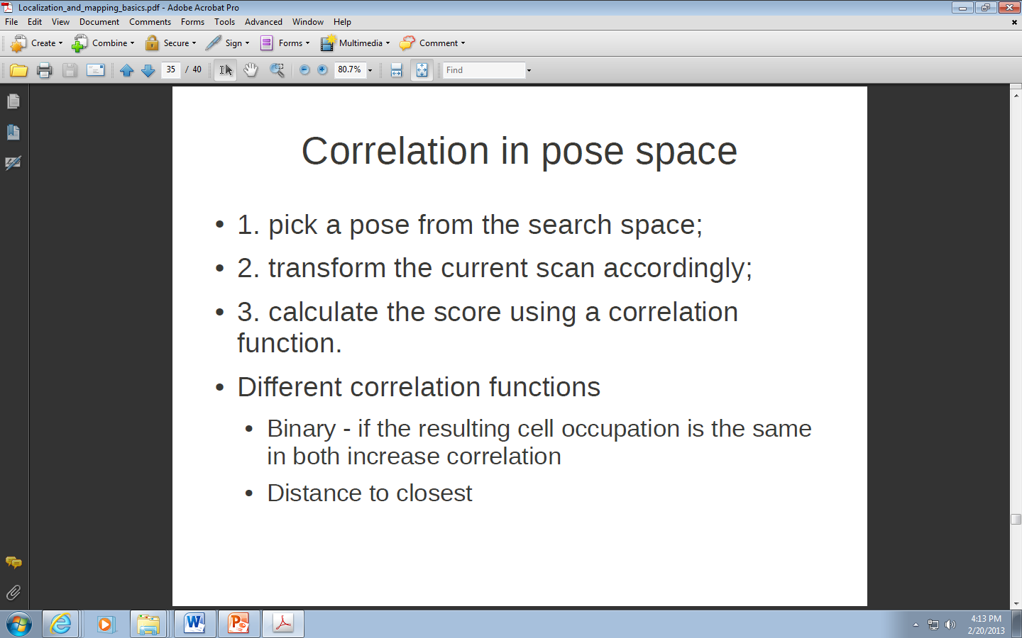

Slide 19
Correlation in pose space

Slide 20
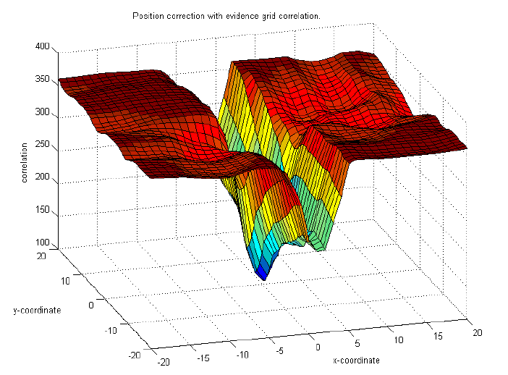
2D correlation

Slide 21
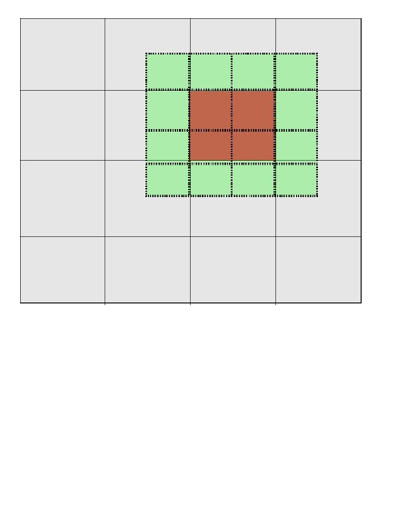
Methods of searching
Even space
Coarse to fine /iterative
Branch and bound

Slide 22
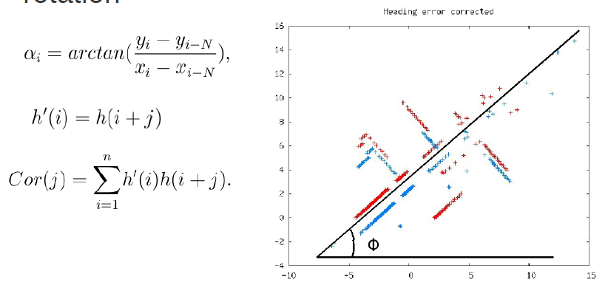
Histogram
Assumption – angle histogram is the same in both scans, it is only sifted by the amount of rotation.

Slide 23
Some reading material
Sensors for Mobile Robots: Theory and Application – H.R Everett
Where am I?" – Systems and Methods for Mobile Robot Positioning (J. Borenstein, H. R. Everett, and L. Feng)
Probabilistic Robotics - Sebastian Thrun, Wolfram Burgard and Dieter Fox
Mobile Robot Localisation and Mapping in Extensive Outdoor Environments – Tim Bailey
A Sensor-Based Personal Navigation System and its Application for Incorporating Humans into a Human-Robot Team - Jari Saarinen
Algorithms for Mobile Robot Localization and Mapping,Incorporating Detailed Noise Modeling and Multi-Scale Feature Extraction Samuel T. Pfister

Slide 25
